Slide 1
Keywords Constants(integer, real, character, string) Literals Variables

Slide 2
Keywords
These are some reserved words in C which have predefined meaning to compiler called keywords.
Keywords are not to be used as variable and constant names.
All keywords have fixed meanings and these meanings cannot be changed.

Slide 3
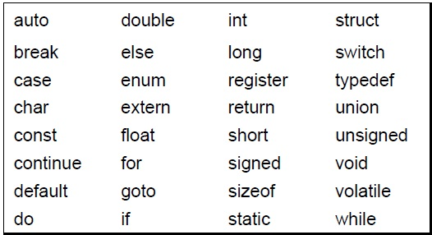
Compiler specific keywords (32)
Some commonly used keywords are given below:

Slide 4
Constants
Constants are data values that cannot be changed during the execution of a program.

Slide 5
Note
A character constant is enclosed in single quotes.
Use single quotes for character constants. Use double quotes for string constants.

Slide 6
Examples of Constant
Constant | Example
Decimal Constant | 10, 20, 450 etc.
Real or Floating-point Constant | 10.3, 20.2, 450.6 etc.
Octal Constant | 021, 033, 046 etc.
Hexadecimal Constant | 0x2a, 0x7b, 0xaa etc.
Character Constant | 'a', 'b', 'x' etc.
String Constant | "c", "c program", "c in javatpoint" etc.

Slide 7
Examples of Integer Constants

Slide 8
Examples of Real Constants

Slide 9
Examples of String Constants

Slide 10
Symbolic Names for Control Characters

Slide 11
Null Characters and Null Strings?

Slide 12
Definition of a Variable:
A variable in C is a named memory location used to store data that can be modified during the execution of a program.

Slide 13
Key Concepts of Variables
1. Declaration of Variables
Before using a variable in C, you must declare it by specifying:
Data Type: The type of data the variable will store.
Variable Name: A name to reference the variable.

Slide 14
int age; // Declares an integer variable
float salary; // Declares a floating-point variable
char grade; // Declares a character variable

Slide 15
Primary (built-in or Basic)Data types
INTEGER
CHARACTER
SIGNED TYPE UNSIGNED TYPE
INT UNSIGNED INT
SHORT INT UNSIGNED SHORT INT
LONG INT UNSIGNED LONG INT
SIGNED CHARACTER
UNSIGNED CHARACTER
FLOATING POINT
VOID
FLOATING POINT TYPE
FLOAT
DOUBLE
LONG DOUBLE
VOID

Slide 17
Rules for Naming Variables
Must begin with a letter (a-z, A-Z) or an underscore (_):
The first character must not be a digit.
Example: int age;, int _counter;
Can contain letters, digits (0-9), and underscores (_):
Variable names can have any combination of letters, digits, and underscores, after the first character.
Example: float price_2024;, char user_name;

Slide 18
Case-sensitive:
C distinguishes between uppercase and lowercase letters, so myVar and myvar are considered different variables.
Example: int Total;, int total; (these are two different variables)

Slide 19
No special characters:
Special characters like @, $, %, etc., are not allowed.
Invalid: float total$; (incorrect)
Cannot be a reserved keyword:
You cannot use C language keywords (like int, return, if, for, etc.) as variable names.
Invalid: int if; (incorrect because if is a keyword)
Length limitation:
While C allows long variable names, some compilers may limit the length (typically up to 31 characters for standard names, and more for long names).

Slide 20
Variables - Examples
int a;
int sum, a1, a2;
int x = 7;
int a;
a = 5;
a1 = a;

